Slide 1
Python club session 3
Macquarie University

Slide 2
Recap of previous lesson
Functions
Arguments
Return values
Default vs positional arguments
Importing functions from a file
Collections
Indexing

Slide 3
Commenting
When programming sometimes we want to annotate our code
This can help us when returning to our code at a later date
This can also help others who may wish to understand what we have done
Comments don’t affect the code

Slide 4
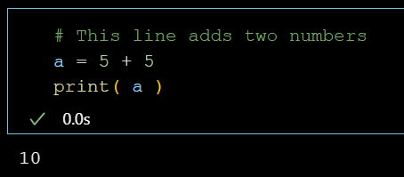
Comment a line
In python we use the hashtag #

Slide 5
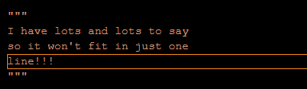
Comment a line
For multi line comments we use triple quote

Slide 6
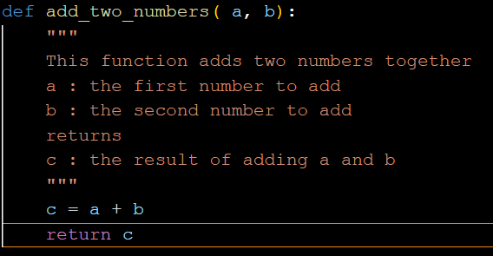
Docstrings
In the beginning of a function we use triple quotation marks to describe what a function does
We often like to describe what each variable is
We also should describe what is returned

Slide 7
Libraries included in Python

Slide 8
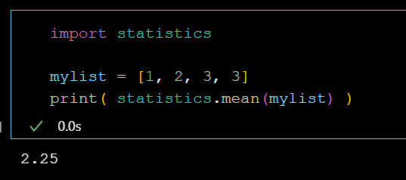
statistics is a commonly used Python library

Slide 9
Task 1
Print the mean, median, and mode of your list using the statistics library

Slide 10
Task 2
Use the math library and the sqrt function to determine the square root of 9409
Use the random library and random function to generate a random number between 0 and 1
Use the statistics library and the correlation function to determine the Pearson correlation between two variables x and y

Slide 11
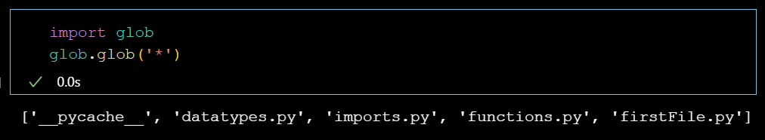
glob
glob is a super useful library
Allows you to search a directory with glob.glob()
Search string uses asterisk to specify what it should search
Returns all matching files as a list

Slide 12
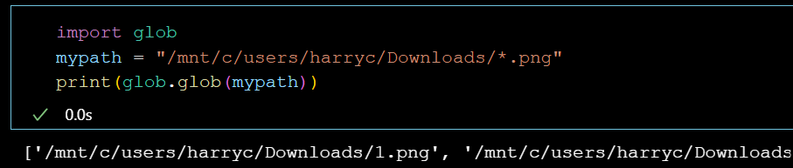

Slide 13
Task 3
List all of a certain file type in a certain folder
Ie; all pngs in the pictures folder
Use glob

Slide 14
How do I know which functions to use in the library
Read the online documentation for that library

Slide 15
User created libraries
There are many community created libraries
These can be installed with pip
pip stands for “pip installs packages”
We run pip in the terminal, as “pip install package_name”

Slide 16
Popular user created packages
Numpy – Numerical python
Pandas – Like excel for python
Matplotlib – plotting graphs
Many more!

Slide 17
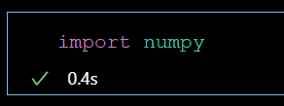

Slide 18
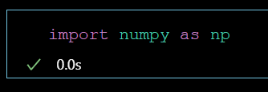
As keyword
Allows you to rename a library when you import it.
Common convention is to rename numpy to np on import

Slide 19
Task 4
Use pip to install numpy
Use pip to install matplotlib
Use pip to install pandas

Slide 20
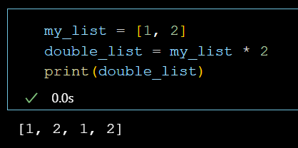
Numpy is useful for operations on arrays
An array is a class which is similar to a list
Mathematical operations don’t make much sense on lists

Slide 21
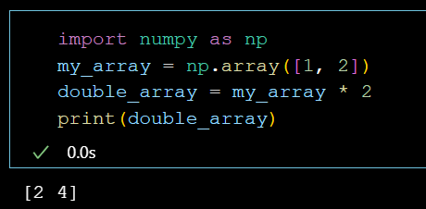
Numpy is useful for operations on arrays
Mathematical operations make sense on arrays

Slide 22
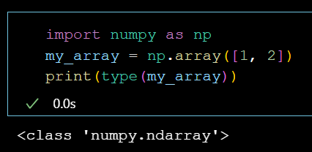
A numpy array is a class

Slide 23
Task 5
Use the np.max function on a list
Describe what it does
Use the np.argmax function on a list
Describe what it does

Slide 24
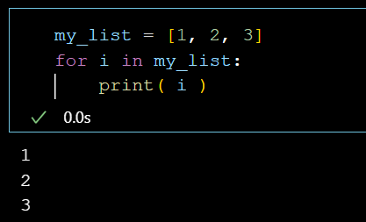
For loops
A for loop is used for iterating through a list

Slide 25
For loops
We indent everything inside the loop
We end the loop by unindenting

Slide 26
Task 6
Try to iterate through a list using a for loop

Slide 27
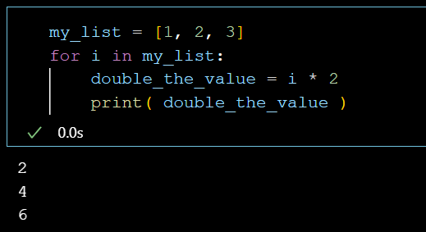
For loops
We can do as much as we would like inside the for loop

Slide 28
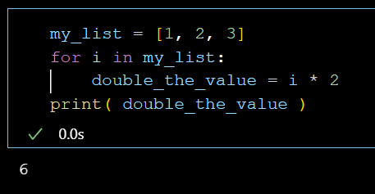
For loops
When we unindent code is no longer inside the loop

Slide 29
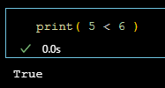
Comparisons
In python we can compare different variables
We should only do this with numbers

Slide 30
Comparison operators
Less than <
Greater than >
Is equal to ==
Not equal to !=

Slide 31
Less than

Slide 32
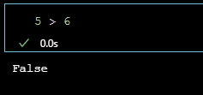
Greater than

Slide 33
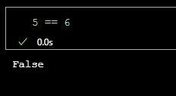
Is equal to

Slide 34
These comparisons result in a Boolean value
True or False

Slide 35
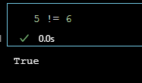
Is not equal to

Slide 36
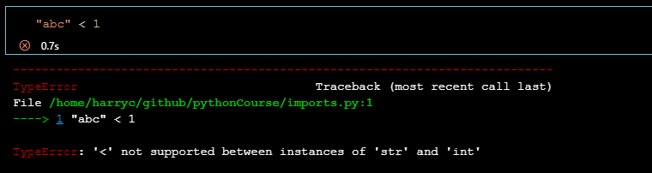
Read the errors, they often make sense

Slide 37
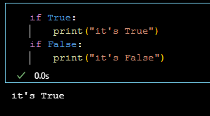
If statements
If statements take a Boolean value and then run code
If the Boolean is True we run code, if it’s false, we don’t
We use the colon and indent everything inside the if statement

Slide 38
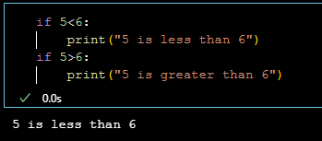
They work really nicely with comparisons

Slide 39
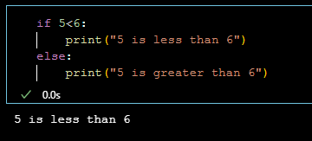
We can combine it with else or elif

Slide 40
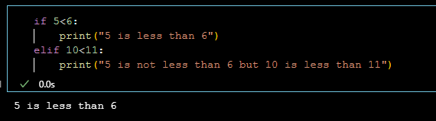
We can combine it with else or elif

Slide 41
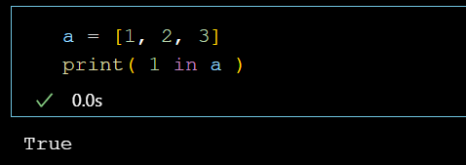
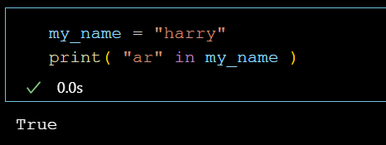
in keyword
You can ask python if something is in something
i in list, checks for full item in list
i in string, checks for substring in string

Slide 42
Task 7
Experiment with the in keyword on your lists and on your strings

Slide 43
More comparison operators
<= less than or equal to
>= greater than or equal to

Slide 44
Control flow
Japan
Skiing
If savings more than $2000
If Winter
Start
Else If savings less than $2000
Else if summer
Tasmania
Swimming

Slide 45
Task 8
Use the file that I sent you via email
Use comparison operators and if statements to determine which country and which activity we will engage in.

Slide 46
Control flow
Japan
Skiing
If savings more than $2000
If Winter
Start
Else If savings less than $2000
Else if summer
Tasmania
Swimming

Slide 47
You guys know 99% of Python!!!

Slide 48
Classes and methods
Classes can be thought of as custom datatypes
Classes and datatypes have methods that can be called on them
These are the same as functions
Methods take the object as an argument implicitly

Slide 49
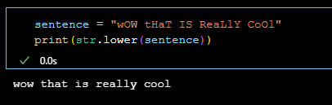
Function Example

Slide 50
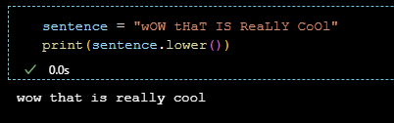
Method example

Slide 51
When a function belongs to a class or datatype, it’s a method

Slide 52
Different datatypes and classes will have different methods
Strings have methods
Lists have methods
Numpy arrays have methods
Pandas dataframes have methods

Slide 53
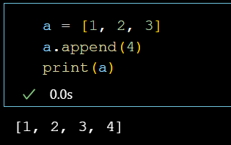
Useful methods
List.append
This modifies the list in place without requiring you assign the result of append to a variable

Slide 54
Task 9
Explore different string methods
Explore different list methods

Slide 55
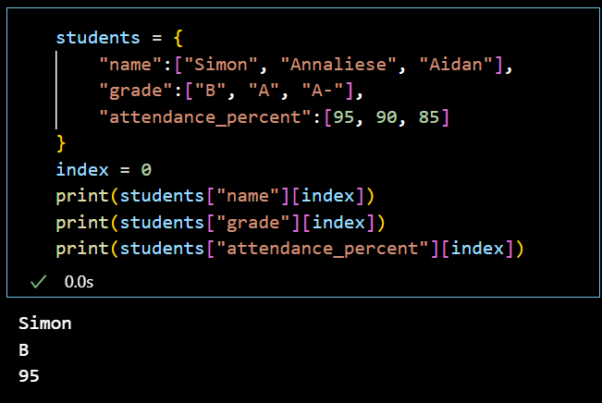
Assignment 1
Start with the code we wrote earlier
Write a function that takes two arguments, the students dictionary and an index
This function should return the values at that index for all keys
Use the numpy library to determine the index of the student which has the highest attendance percentage
Pass the index to your function and then print the values it returns

Slide 56
Assignment 2
Combine your knowledge of if statements, for loops, the in keyword, and list methods
Complete this code to append all names that include the letter a

